Slide 1
AI system personalizes software interfaces in real time using user behavior and feedback
24-25J-296

Slide 2
Introduction to Overall Research Project
Our research project is an AI system that personalizes software interfaces in real-time to enhance user experiences.
This plugin uses advanced algorithms and AI to enhance software interface personalization.
Addressed challenges are limited initial data, inadequate adaptation, and lack of transparency.
This Research Project enhances personalization and efficiency by addressing these key issues.

Slide 3
Overall Research Project
Problem Statement
Limited interaction history for new users.
Leads to less personalized and relevant recommendations for software user interfaces.
Needs more smart techniques to make accurate guesses with very little information.
Not using enough smart customization features that understand the user's situation and learn from their actions.
Results in less responsive and tailored user experiences.
Needs for better integration of the above for effective personalization.

Slide 4
Overall Research Project
Research Questions
What are the best practices for integrating user feedback into the AI system for continuous improvement?
How can AI-driven personalization improve overall user satisfaction and engagement?
How can user feedback be quantitatively and qualitatively measured to assess the system's performance?
What types of feedback mechanisms can be integrated to facilitate continuous learning and improvement of the AI system?

Slide 5
Overall Research Project
Research Questions
How can reinforcement learning be used to enhance the personalization process based on user feedback?
How can AI-based mechanisms be used to dynamically adjust UI variants in response to evolving user preferences?

Slide 6
Research Project Objectives
Main Objective
The project’s goal is to create an AI system that personalizes software interfaces in real-time.
It adjusts based on user behavior, preferences, and feedback to boost satisfaction and engagement by tailoring the software environment to individual needs.

Slide 7
Research Project Sub - Objectives
Adjusts UI/UX based on user behavior and preferences.
Tailors experiences to boost satisfaction and interaction.
Adapts software environment to individual needs.
Utilizes probabilistic models and reinforcement learning for adaptability.
Improves browsing for users with visual disabilities.

Slide 8
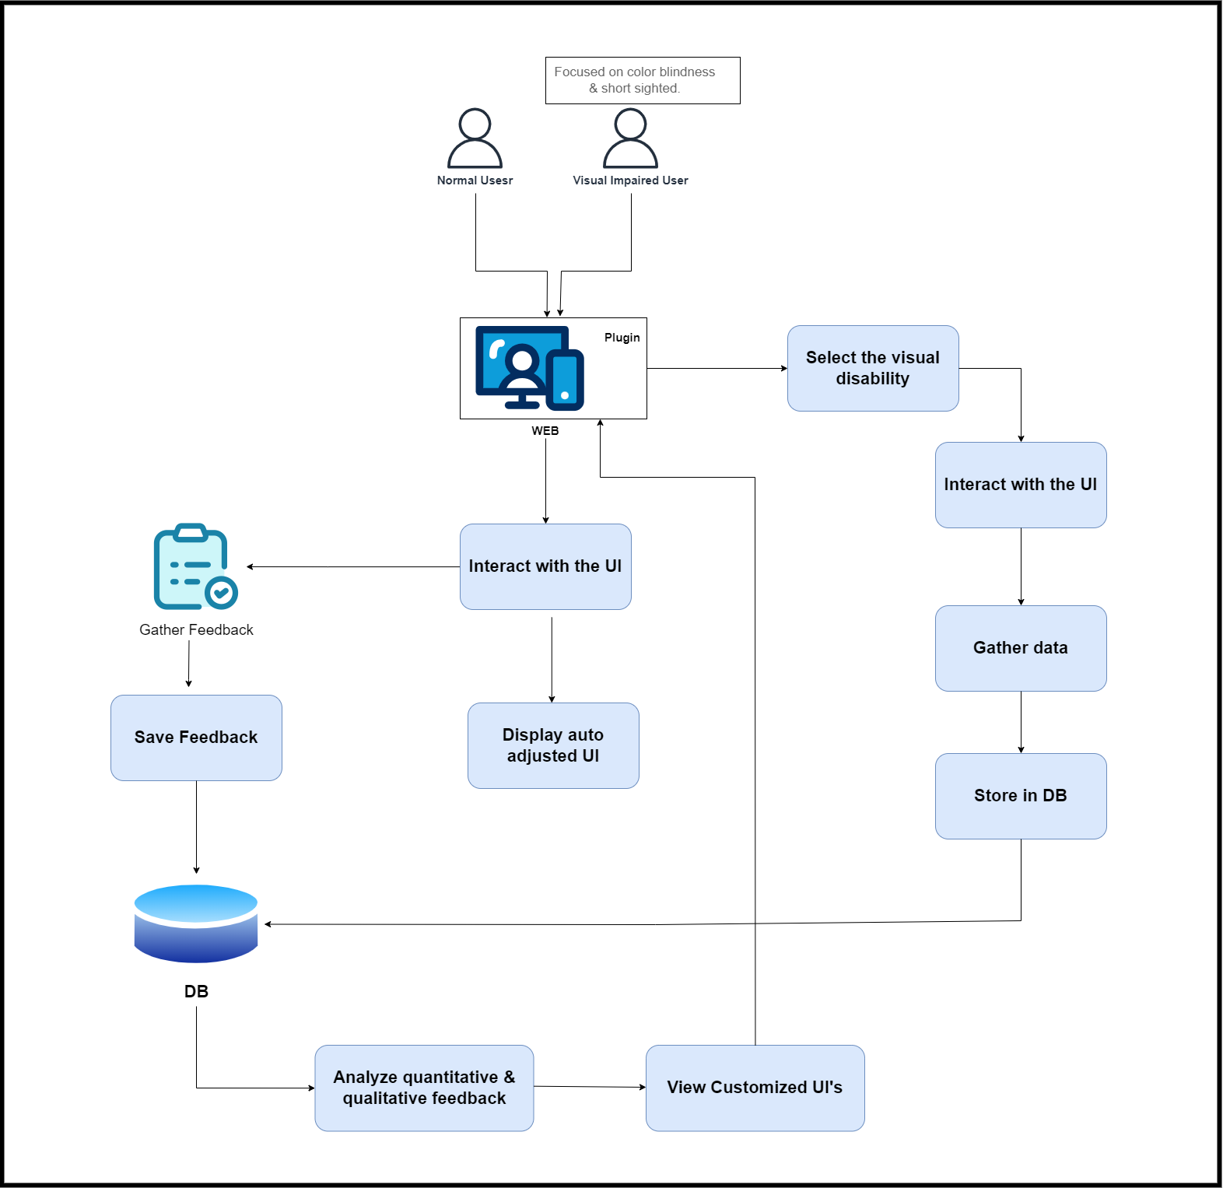
Overall System Diagram

Slide 9
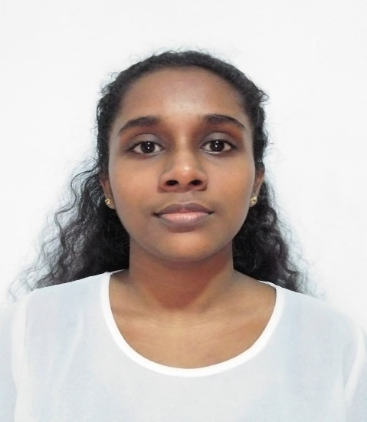
IT21324406 | Silva H.S.N
Software Engineering
IT21324406 | Silva H.S.N | 24-25J-296

Slide 10
Software User Interface Personalization through User Feedback
IT21324406 | Silva H.S.N | 24-25J-296

Slide 11
Research Question
What are the best practices for integrating user feedback into the AI system for continuous improvement?
How can AI-driven personalization improve overall user satisfaction and engagement through user feedback?
How can user feedback be quantitatively and qualitatively measured for user interface personalization?
What types of feedback mechanisms can be integrated to facilitate continuous learning and improvement of the AI system?
IT21324406 | Silva H.S.N | 24-25J-296

Slide 12
Specific and Sub Objectives
Real-time feedback integration for UI personalization
Collect real-time user feedback.
Analyze user behavior through feedback.
Process and analyze feedback.
Adapt user interface dynamically through the model.
Establish a feedback loop.
Integrate feedback mechanisms.
Give UI suggestions to the user according to the feedback.
IT21324406| Silva H.S.N | 24-25J-296

Slide 13
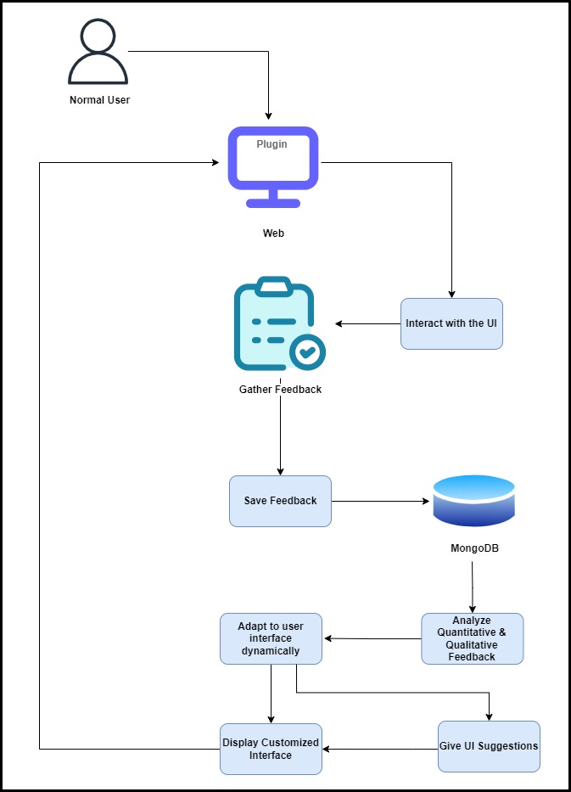
System Diagram
IT21324406| Silva H.S.N | 24-25J-296

Slide 14
Methodology
Technologies:
Collect User Feedback: In-App Surveys and Pop-Up Forms
Process and Analyze Feedback through model: Natural Language Toolkit
Feedback Classification: TensorFlow
Feedback Loop: Apache Kafka
Programming Languages and Tools: React.js, Python, RESTful API
Database: MongoDB
Development Environment: Visual Studio Code
Version Control: Git and GitHub
IT21324406 | Silva H.S.N | 24-25J-296

Slide 15
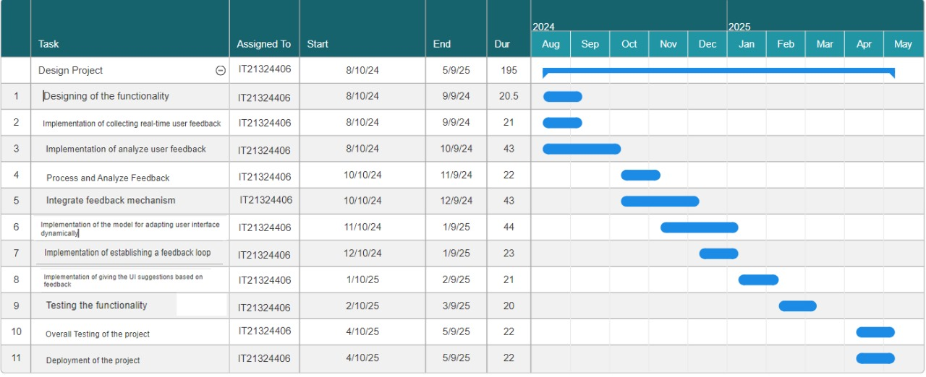
Completion of the project
IT21324406 | Silva H.S.N | 24-25J-296

Slide 16
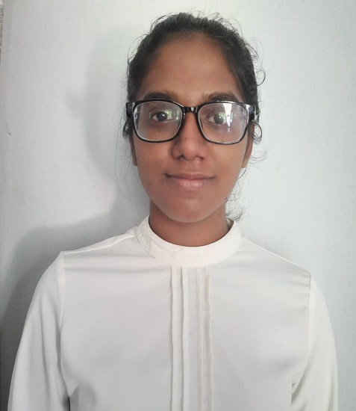
IT21215360 | Rosa M.D
Software Engineering
IT21215360 | Rosa M.D | 24-25J-296

Slide 17
Software User Interface Personalization through User Behavior
IT21215360 | Rosa M.D | 24-25J-296

Slide 18
Research Questions
•What probabilistic models are suitable for managing uncertainty and predicting user behavior in adaptive systems?
•How can reinforcement learning be used to enhance the personalization process based on user feedback?
•How can AI-based mechanisms be used to dynamically adjust UI variants in response to evolving user preferences?
IT21215360 | Rosa M.D | 24-25J-296

Slide 19
Specific and Sub Objectives
Advanced Personalization through AI
•Use AI, including probabilistic models and reinforcement learning.
•Create a personalized user interface.
•Adapt to user preferences and behaviors.
•Improve user experience by predicting needs.
•Adjust the UI in real-time.
IT21215360 | Rosa M.D | 24-25J-296

Slide 20
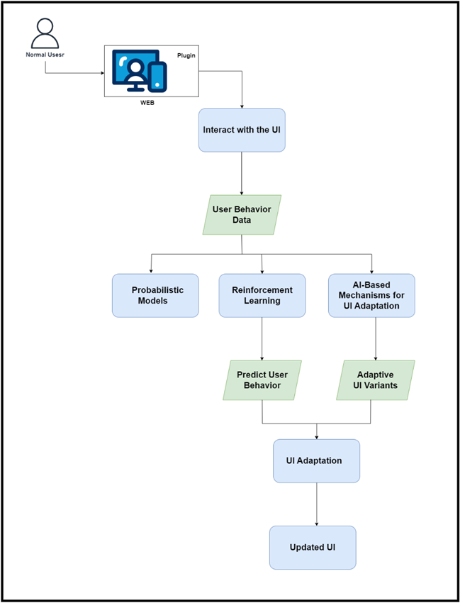
System Diagram
IT21215360 | Rosa M.D | 24-25J-296

Slide 21
Methodology
Technologies:
•Probabilistic Models: Bayesian networks, Hidden Markov Models
•Reinforcement Learning: Q-learning algorithms
•AI Mechanisms for UI Adaptation: Neural networks
•Programming Languages and Tools: Python, TensorFlow, PyTorch
•Development Environment: Visual Studio Code
•Version Control: Git and GitHub
IT21215360 | Rosa M.D | 24-25J-296

Slide 22
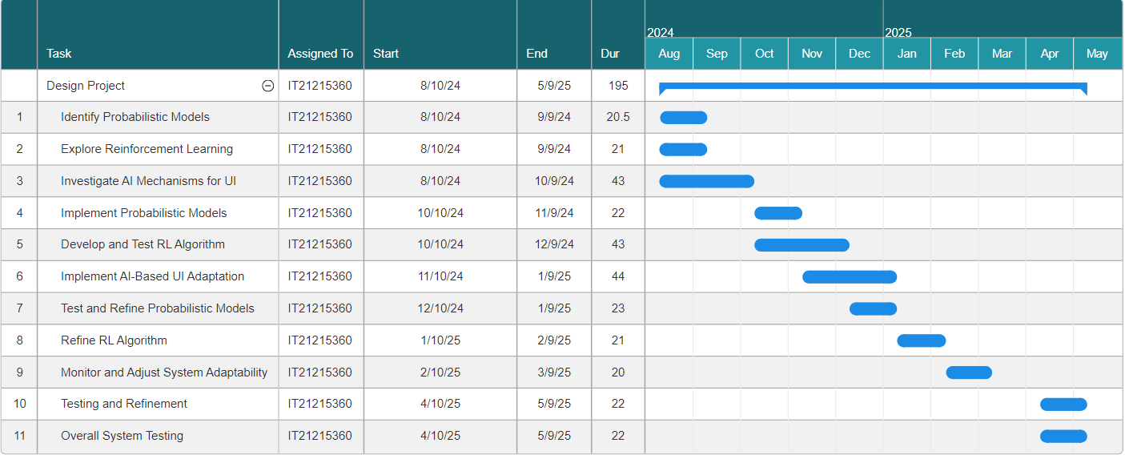
Completion of the project
IT21215360 | Rosa M.D | 24-25J-296

Slide 23

IT17117210 | SaNDUN Geemal H.L
Information Technology
IT17117210 | Sandun Geemal H.L | 24-25J-296

Slide 24
Improving Browsing Experience for Users with Visual Disabilities
IT17117210 | Sandun Geemal H.L | 24-25J-296

Slide 25
Research Questions
What are the most effective types of interactive tests for detecting different visual disabilities?
What are the user experience impacts of implementing dynamic adjustments to text sizes, contrast settings, and color schemes for visually impaired users?
How can adaptive user interfaces be designed to effectively accommodate the diverse visual needs of users with disabilities, such as color blindness and short-sightedness?
IT17117210 | Sandun Geemal H.L | 24-25J-296

Slide 26
Specific and Sub Objectives
Develop Interactive Tests for Visual Impairments
Apply machine learning models trained on the dataset to analyze user responses in real-time.
Dynamic Adjustment of Browser Settings
Dynamically adjust text sizes, contrast settings, and color schemes based on user test results
Develop Customizable User Interface
Allows users to customize their browser settings based on their accessibility preferences.
Implement Real-Time Adaptation
ensuring immediate application of changes without requiring page reloads
IT17117210 | Sandun Geemal H.L | 24-25J-296

Slide 27
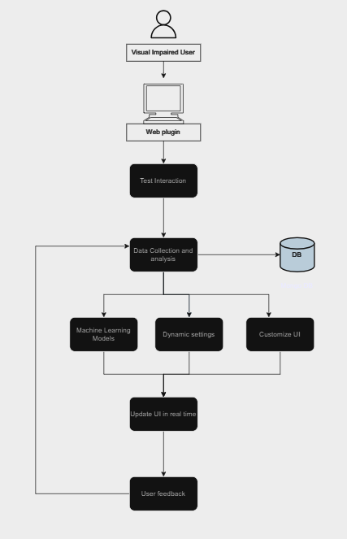
System Diagram
IT17117210 | Sandun Geemal H.L | 24-25J-296

Slide 28
Methodology
Interactive Tests Development: Web tests and Pop-Up Forms
Data Collection and Machine Learning Analysis : MongoDB, scikit-learn, TensorFlow
Test data Classification: TensorFlow
Dynamic Adjustment of Browser Settings: CSS variables,
Customizable User Interface Development: React, Material-UI.
Real-Time Adaptation Implementation: WebSockets ,Firebase
Programming Languages and Tools: React.js, Python, RESTful API
Database: MongoDB
Version Control: Git and GitHub
IT17117210 | Sandun Geemal H.L | 24-25J-296

Slide 29
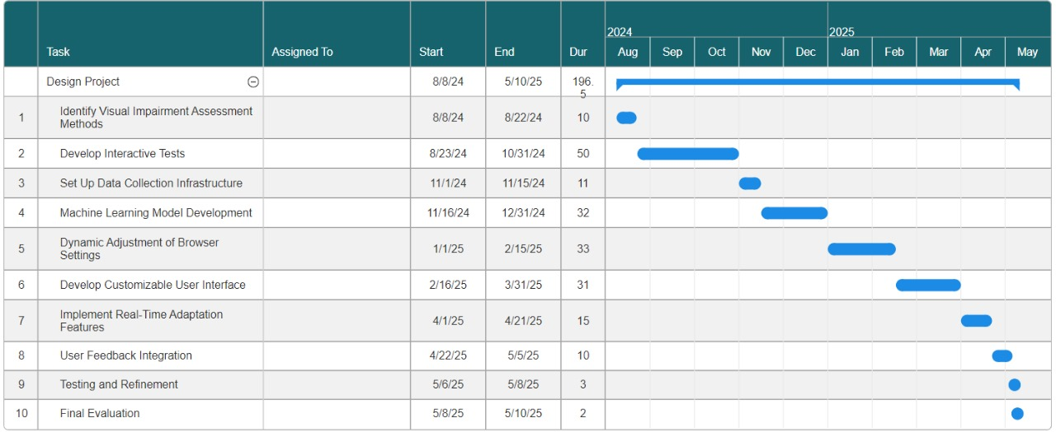
Completion of the project
IT17117210 | Sandun Geemal H.L | 24-25J-296

Slide 30
References
[1] M. Sili, M. Garschall, M. Morandell, S. Hanke, and C. Mayer, "Personalization in the User Interaction Design," in HCI 2016, Part I, LNCS 9731, Springer, 2016, pp. 198–207. DOI: 10.1007/978-3-319-39510-4_19
[2] M. C. Schraefel, "Building Dynamic Systems for Universal Usability: The Value of User Experience Design," in Universal Access in Human-Computer Interaction. Design and Development Methods for Universal Access, Springer, 2015, pp. 47–56. DOI: 10.1007/978-3-319-18374-9_5
[3] T. Jokela and K. H. Tammi, "User Experiences in Context-Aware Mobile Applications," in Human-Computer Interaction – INTERACT 2015, Springer, 2015, pp. 36–44. DOI: 10.1007/978-3-319-18374-9_5
[4] M. Monteiro-Guerra, et al., "Personalization in Real-Time Physical Activity Coaching," IEEE Journal of Biomedical and Health Informatics, vol. 23, no. 1, pp. 1-12, 2019
[5] F. Villaça, et al., "Analyzing the Usability and User Experience of Telemonitoring Systems for Chronic Patients," Journal of Biomedical and Health Informatics, vol. 21, no. 1, pp. 1-12, 2017
[6] T. Nieminen, et al., "Designing a Context-Aware Mobile Application for Real-Time Physical Activity Coaching," IEEE Journal of Biomedical and Health Informatics, vol. 20, no. 1, pp. 1-12, 2016

